Slide 1

Basics of Cryptography

Slide 2
Contents
Network Security.
Security Goals.
Security Attacks.
Security Services and Mechanisms.
Cryptography.
Types of Cryptosystems.
Cryptanalysis attacks.
Message Integrity and Authentication.
Digital Signature.

Slide 3
Network Security
Network security consists of the policies and practices adopted to prevent and monitor unauthorized access, misuse, modification, or denial of a computer network and network-accessible resources.
In its simplest term, it is a set of rules and configurations designed to protect the integrity, confidentiality and accessibility of computer networks and data using both software and hardware technologies.

Slide 4

Security Goals

Slide 5
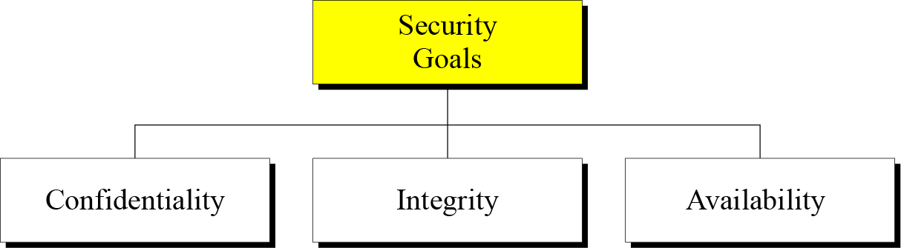
Security Goals
Figure: Taxonomy of security goals

Slide 6

Confidentiality
Confidentiality is probably the most common aspect of information security. We need to protect our confidential information.
An organization needs to guard against those malicious actions that endanger the confidentiality of its information.

Slide 7

Integrity
Information needs to be changed constantly. Integrity means that changes need to be done only by authorized entities and through authorized mechanisms.

Slide 8

Availability
The information created and stored by an organization needs to be available to authorized entities. Information needs to be constantly changed, which means it must be accessible to authorized entities.

Slide 9

Security Attacks

Slide 10
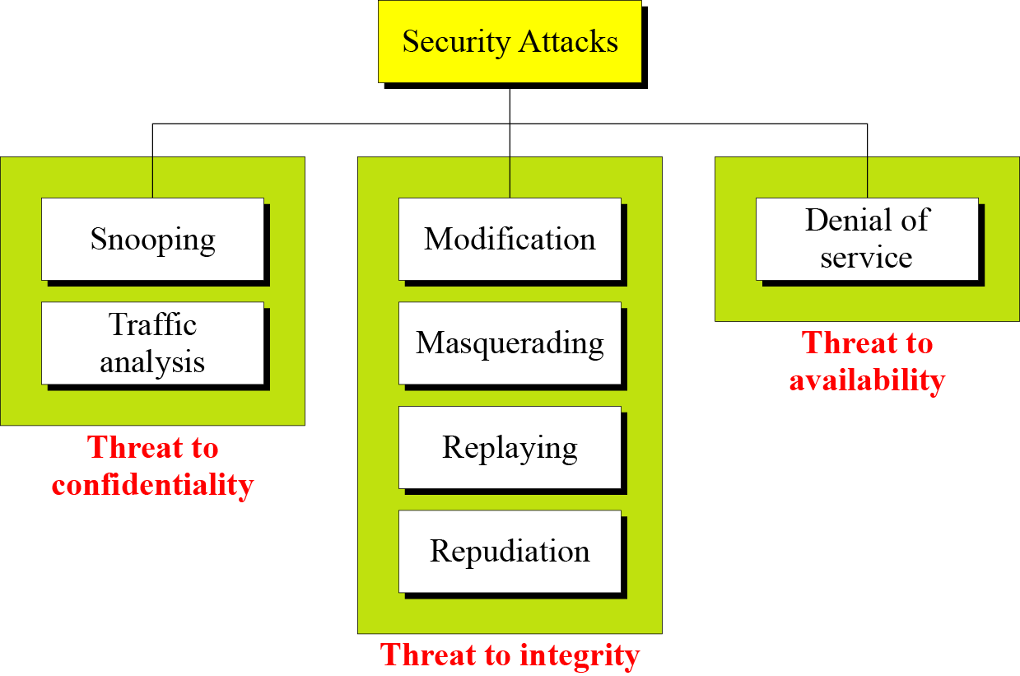
Security Attacks
Figure: Taxonomy of security attacks

Slide 11
Attacks Threatening Confidentiality
Snooping refers to unauthorized access to or interception of data.
Traffic analysis refers to obtaining some other type of information by monitoring online traffic.
Attacks Threatening Availability
Denial of service (DoS) is a very common attack. It may slow down or totally interrupt the service of a system.

Slide 12
Attacks Threatening Integrity
Modification means that the attacker intercepts the message and changes it.
Masquerading or spoofing happens when the attacker impersonates somebody else.
Replaying means the attacker obtains a copy of a message sent by a user and later tries to replay it.
Repudiation means that sender of the message might later deny that she has sent the message; the receiver of the message might later deny that he has received the message.

Slide 13

Security Services and Mechanisms

Slide 14
Services and Mechanism
ITU-T (International Telecommunication Union-Telecommunication) provides some security services and some mechanisms to implement those services. Security services and mechanisms are closely related because a mechanism or combination of mechanisms are used to provide a service.

Slide 15
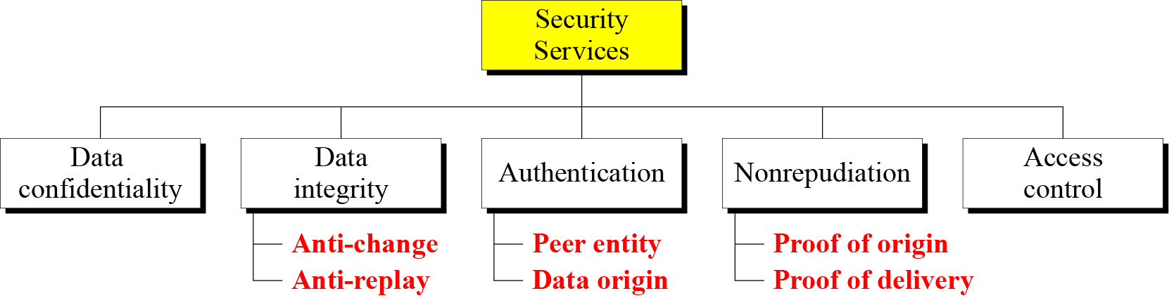
Security Services
Figure: Security services
It is easy to relate one or more of these services to one or more security goals.
It can be seen that these services has been designed to prevent security attacks.

Slide 16
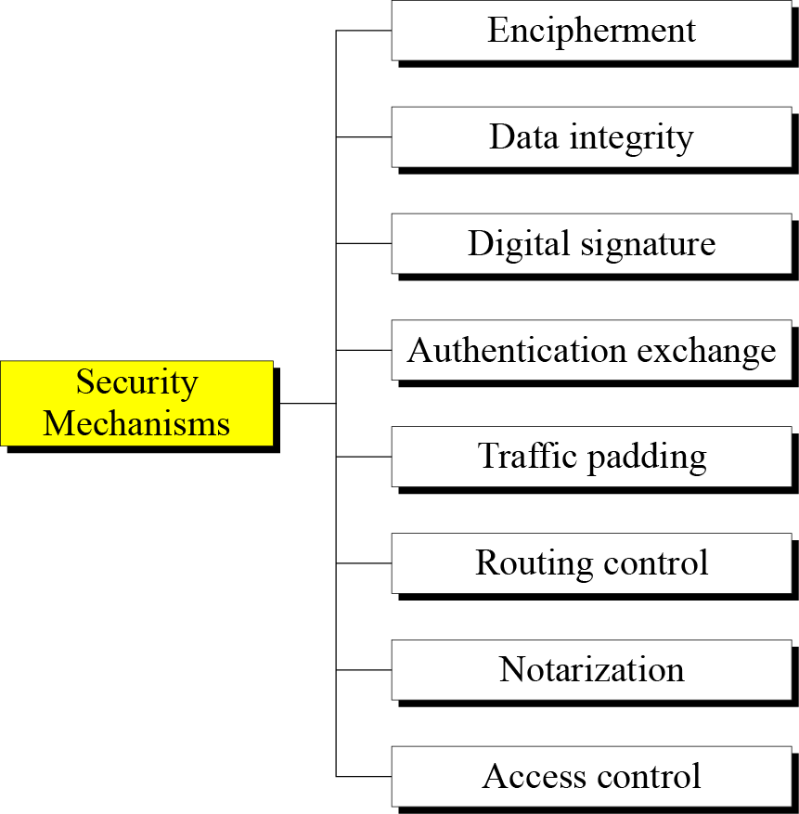
Security Mechanisms
Figure: Security mechanisms

Slide 17
Encipherment means hiding or covering data that can provide confidentiality.
Data Integrity mechanisms appends to the data a short checkvalue created from the data itself and receiver creates new checkvalue from received data and compare new checkvalue with the received checkvalue.
Digital signature is a means of electronically sign the data and the receiver can electronically verify the signature.
Authentication Exchange means two entities exchange some message to prove their identity to each other.

Slide 18
Traffic Padding means inserting some bogus data into data traffic to thwart the adversary’s attempt to use the traffic analysis.
Routing Control means selecting and continuously changing different available routes between sender and receiver.
Notarization means selecting trusted third party to control communication between two entities.
Access Control means to prove user has access right to data e.g.. Passwords and PINs.

Slide 19
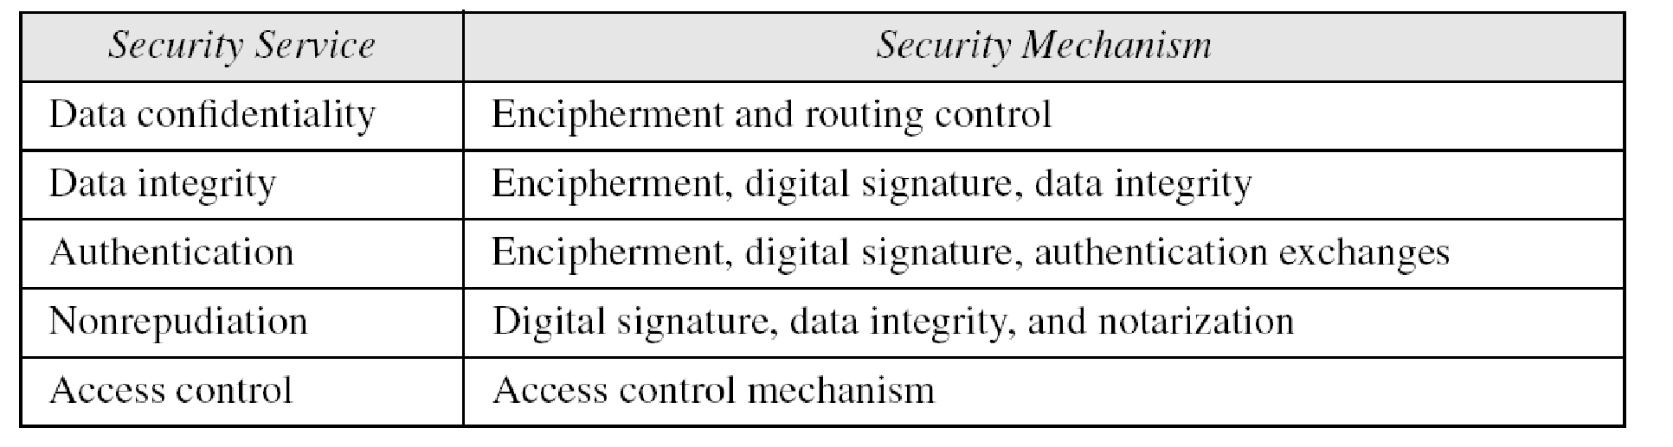
Table: Relation between security services and mechanisms.

Slide 20
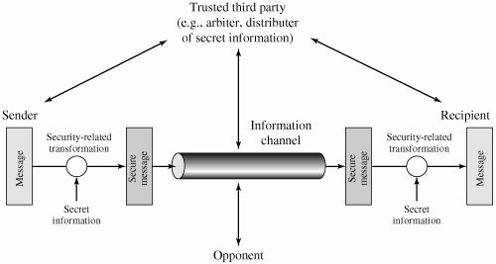
Model for Network security

Slide 21

Techniques
Mechanisms discussed are only theoretical recipes to implement security. The actual implementation of security goals needs some techniques. Two techniques are prevalent today: cryptography and steganography.
The technique we will focus is cryptography.

Slide 22

Cryptography

Slide 23
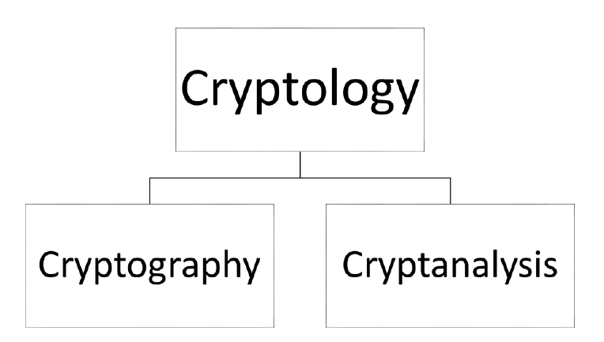
Context of Cryptography
Cryptology, the study of cryptosystems, can be subdivided into two branches:

Slide 24
Cryptography:- Origin
Human being from ages had two inherent needs: (a) to communicate and share information and (b) to communicate selectively.
These two needs gave rise to the art of coding the messages in such a way that only the intended people could have access to the information.
Unauthorized people could not extract any information, even if the scrambled messages fell in their hand.
The word ‘cryptography’ was coined by combining two Greek words, ‘Krypto’ meaning hidden and ‘graphene’ meaning writing.

Slide 25
Cryptography
The art and science of concealing the messages to introduce secrecy in information security is recognized as cryptography.
Cryptography deals with the actual securing of digital data. It refers to the design of mechanisms based on mathematical algorithms that provide fundamental information security services.

Slide 26
Cryptanalysis
The art and science of breaking the cipher text is known as cryptanalysis.
Cryptanalysis is the sister branch of cryptography and they both co-exist.
The cryptographic process results in the cipher text for transmission or storage. It involves the study of cryptographic mechanism with the intention to break them.
Cryptanalysis is also used during the design of the new cryptographic techniques to test their security strengths.
Note: Cryptography concerns with the design of cryptosystems, while cryptanalysis studies the breaking of cryptosystems.

Slide 27
Cryptosystem
A cryptosystem is an implementation of cryptographic techniques and their accompanying infrastructure to provide information security services. A cryptosystem is also referred to as a cipher system.

Slide 28
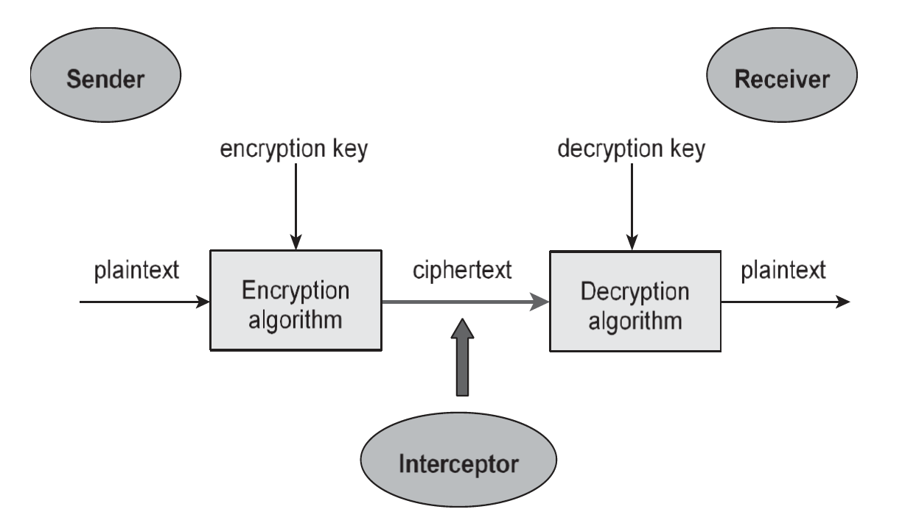
Cryptosystem Continues:
Figure shows a sender who wants to transfer some sensitive data to a receiver in such a way that any party intercepting or eavesdropping on the communication channel cannot extract the data.
The objective of this simple cryptosystem is that at the end of the process, only the sender and the receiver will know the plaintext.

Slide 29
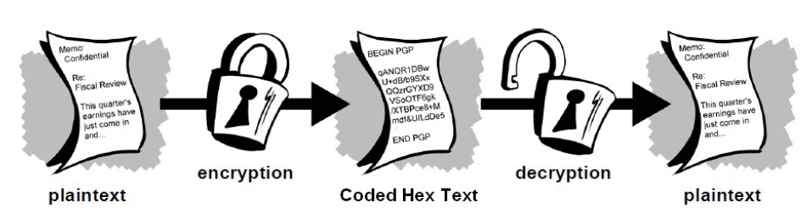
Components of Cryptosystem
The various components of a basic cryptosystem are as follows:
Plaintext
Encryption Algorithm
Ciphertext
Decryption Algorithm
Encryption Key
Decryption Key

Slide 30
Plaintext: It is the data to be protected during transmission.
Encryption Algorithm: It is a mathematical process that produces a ciphertext for any given plaintext and encryption key.
Ciphertext: It is the scrambled version of the plaintext produced by the encryption algorithm using a specific the encryption key.
Decryption Algorithm: It is a mathematical process, that produces a unique plaintext for any given ciphertext and decryption key.

Slide 31
Encryption Key: It is a value that is known to the sender. The sender inputs the encryption key into the encryption algorithm along with the plaintext in order to compute the ciphertext.
Decryption Key. It is a value that is known to the receiver. The decryption key is related to the encryption key, but is not always identical to it. The receiver inputs the decryption key into the decryption algorithm along with the ciphertext in order to compute the plaintext.

Slide 32
For a given cryptosystem, a collection of all possible decryption keys is called a key space.
An interceptor (an attacker) is an unauthorized entity who attempts to determine the plaintext. He can see the ciphertext and may know the decryption algorithm. He, however, must never know the decryption key.

Slide 33

Types of Cryptosystem
Fundamentally, there are two types of cryptosystems based on the manner in which encryption-decryption is carried out in the system:
The main difference between these cryptosystems is the relationship between the encryption and the decryption key
Symmetric Key Encryption
Asymmetric Key Encryption

Slide 34

Symmetric Key Encryption
The encryption process where the sender and receiver of a message share a single, common key that is used to encrypt and decrypt the message is known as Symmetric Key Encryption.
The study of symmetric cryptosystems is referred to as symmetric cryptography. Symmetric cryptosystems are also sometimes referred to as secret key cryptosystems.
The Algorithm use is also known as a secret key algorithm or sometimes called a symmetric algorithm.

Slide 35
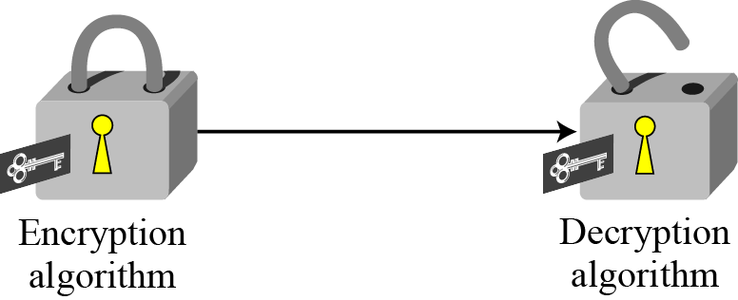
Symmetric Key Encryption
Figure: Locking and unlocking with the same key

Slide 36
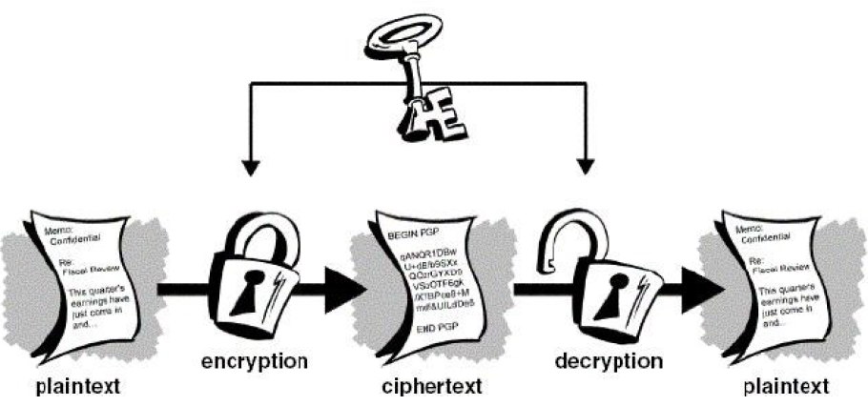
Symmetric Key Encryption
The key for encrypting and decrypting the file had to be known to all the recipients. Else, the message could not be decrypted by conventional means.

Slide 37
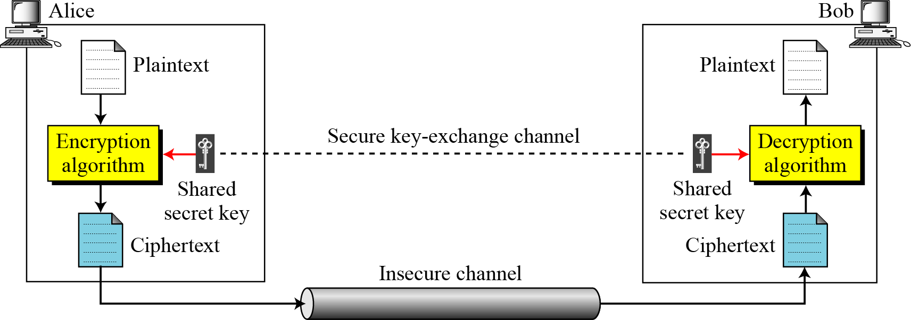
Symmetric Key Encryption
In a group of n people, to enable two-party communication between any two persons, the number of keys required for group is n × (n – 1)/2.

Slide 38
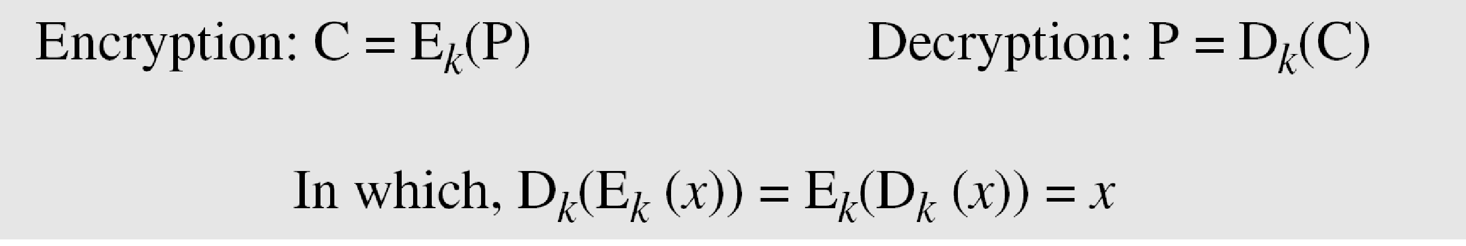
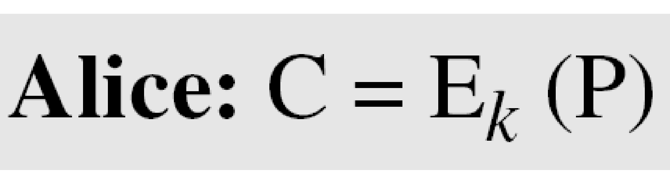
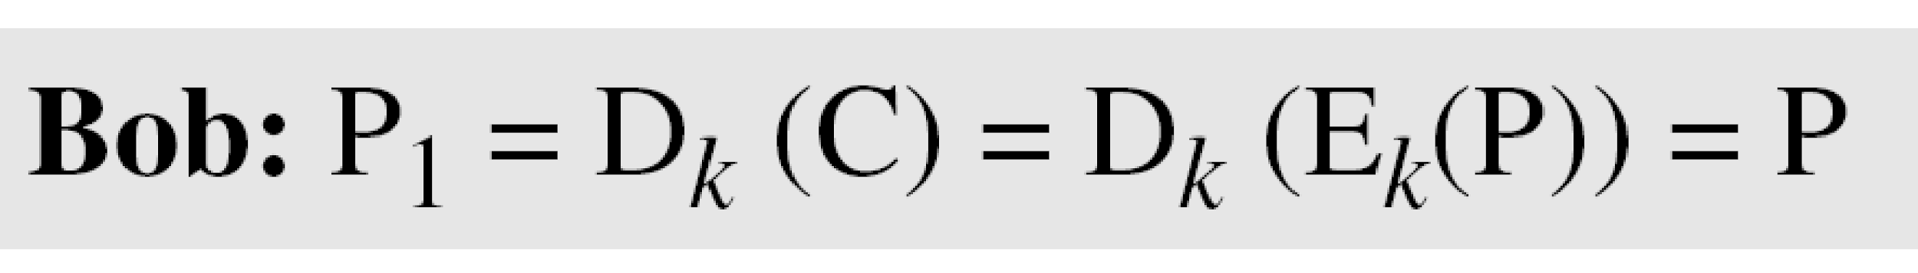
Symmetric Key Encryption
If P is the plaintext, C is the ciphertext, and K is the key,
We assume that Bob creates P₁; we prove that P₁ = P:

Slide 39
Kerckhoff’s Principle
Based on Kerckhoff’s principle, one should always assume that the adversary, Eve (Attacker), knows the encryption/decryption algorithm. The resistance of the cipher to attack must be based only on the secrecy of the key.

Slide 40
Challenge of Symmetric Key Cryptosystem
There are two restrictive challenges of employing symmetric key cryptography.
Key establishment : Before any communication, both the sender and the receiver need to agree on a secret symmetric key. It requires a secure key establishment mechanism in place.
Trust Issue : Since the sender and the receiver use the same symmetric key, there is an implicit requirement that the sender and the receiver ‘trust’ each other.
These two challenges are highly restraining for modern day communication. Today, people need to exchange information with non-familiar and non-trusted parties. These limitations of symmetric key encryption gave rise to asymmetric key encryption schemes.

Slide 41
Asymmetric Key Encryption
Asymmetric cryptography, also known as Public-key cryptography, refers to a cryptographic algorithm which requires two separate keys, one of which is private and one of which is public. The public key is used to encrypt the message and the private one is used to decrypt the message.
Though the keys are different, they are mathematically related and hence, retrieving the plaintext by decrypting ciphertext is feasible.

Slide 42
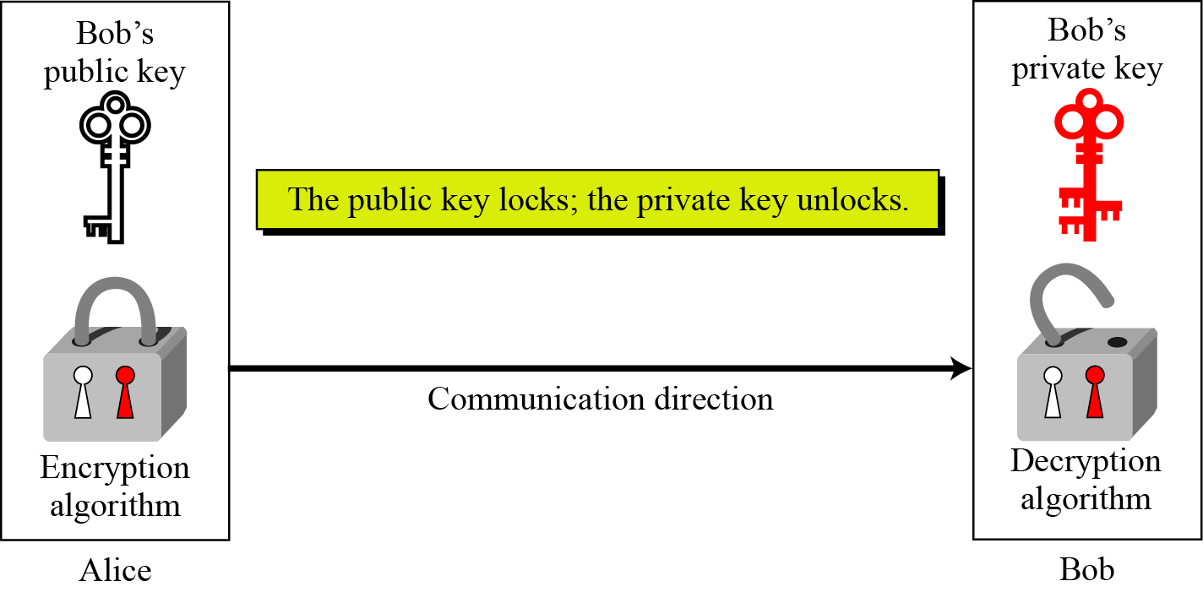
Asymmetric Key Encryption
Figure: Locking and unlocking in asymmetric-key cryptosystem

Slide 43
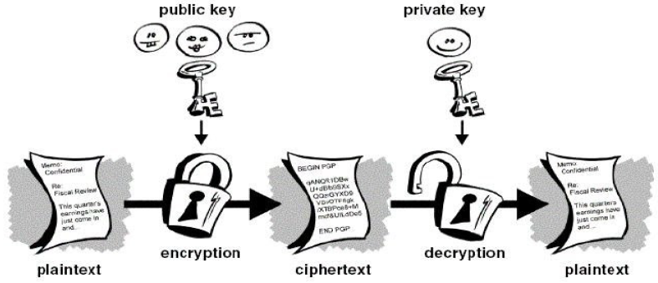
Asymmetric Key Encryption
Every user in this system needs to have a pair of dissimilar keys, private key and public key.

Slide 44
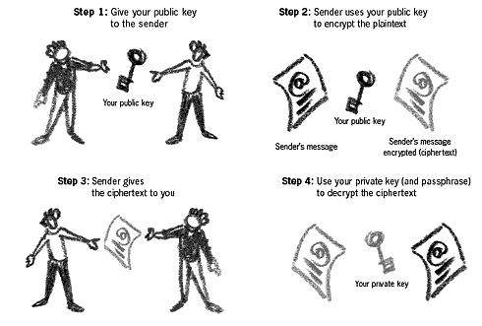
Asymmetric Key Encryption

Slide 45
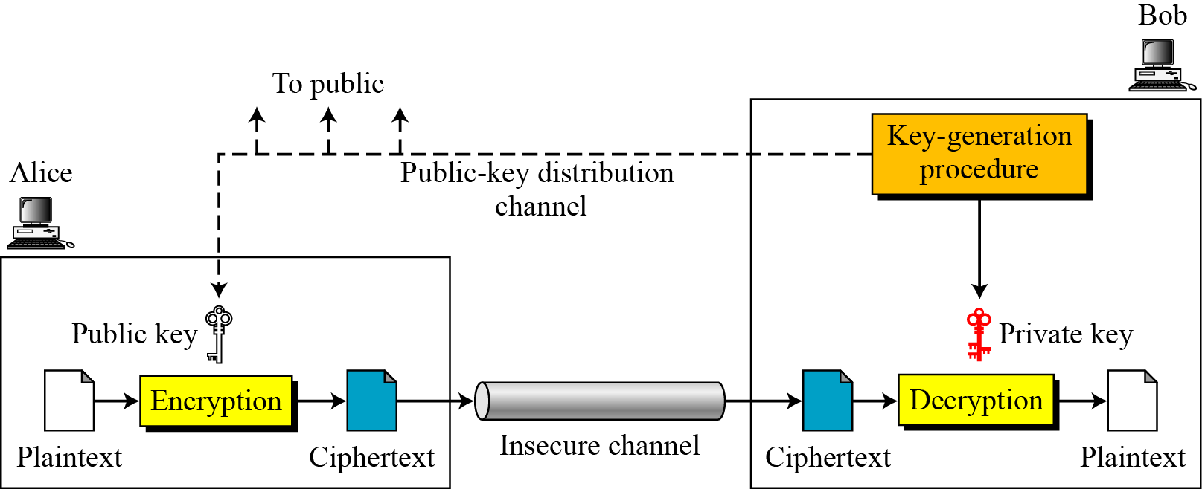
Asymmetric Key Encryption
Though public and private keys of the user are related, it is computationally not feasible to find one from another. This is a strength of this scheme.

Slide 46
Asymmetric Key Encryption
Plaintext/Ciphertext
Unlike in symmetric-key cryptography, plaintext and ciphertext are treated as integers in asymmetric-key cryptography.
Encryption/Decryption
C = f (K_{public} , P) P = g(K_{private} , C)

Slide 47
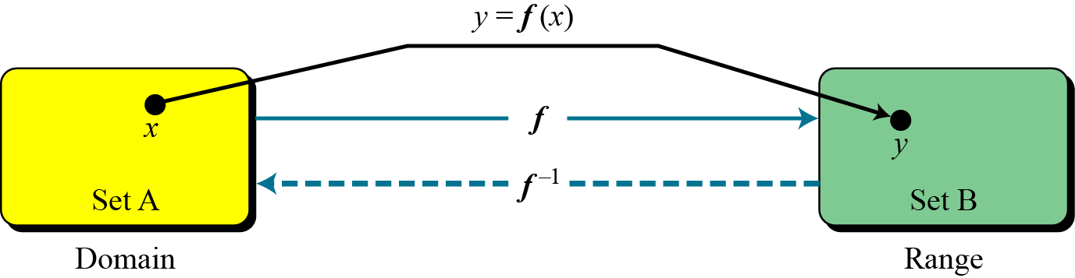
Trapdoor One-Way Function
The main idea behind asymmetric-key cryptography is the concept of the trapdoor one-way function.
Figure: A function as rule mapping a domain to a range

Slide 48
One-Way Function (OWF) satisfies following two properties:
f is easy to compute.
f −1 is difficult to compute
Trapdoor One-Way Function (TOWF) satisfies another property along with above two.
Given y and a trapdoor (secret), x can be computed easily.

Slide 49
Challenge of Public Key Cryptosystem
Public-key cryptosystems have one significant challenge: the user needs to trust that the public key that he is using in communications with a person really is the public key of that person.
This is usually accomplished through a Public Key Infrastructure (PKI) consisting a trusted third party. The third party securely manages and attests to the authenticity of public keys.

Slide 50
Pretty Good Privacy (PGP)
PGP combines some of the best features of both conventional and public key cryptography.
PGP first compresses the plaintext. Data compression saves modem transmission time and disk space and, more importantly, strengthens cryptograph.
Most cryptanalysis techniques exploit patterns found in the plaintext to crack the cipher.
Compression reduces these patterns in the plaintext, thereby greatly enhancing resistance to cryptanalysis security.

Slide 51
Pretty Good Privacy (PGP)
Encryption:
PGP creates a session key, which is a one-time-only secret key.
The session key works with a very secure, fast conventional encryption algorithm to encrypt the plaintext; the result is ciphertext.
Once the data is encrypted, the session key is then encrypted to the recipient’s public key.
This public key-encrypted session key is transmitted along with the ciphertext to the recipient.

Slide 52
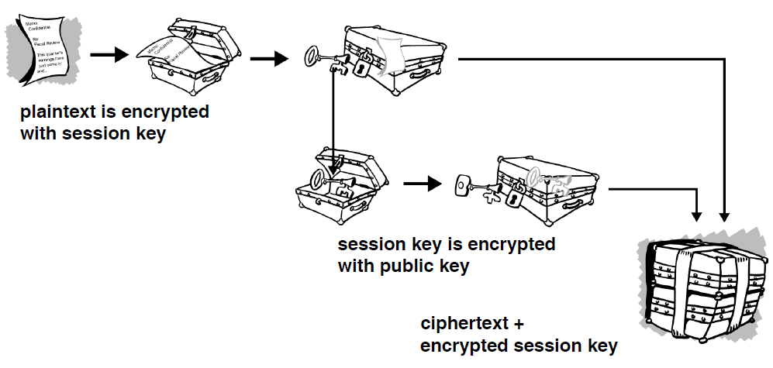
Pretty Good Privacy (PGP)
Figure: PGP Encryption

Slide 53
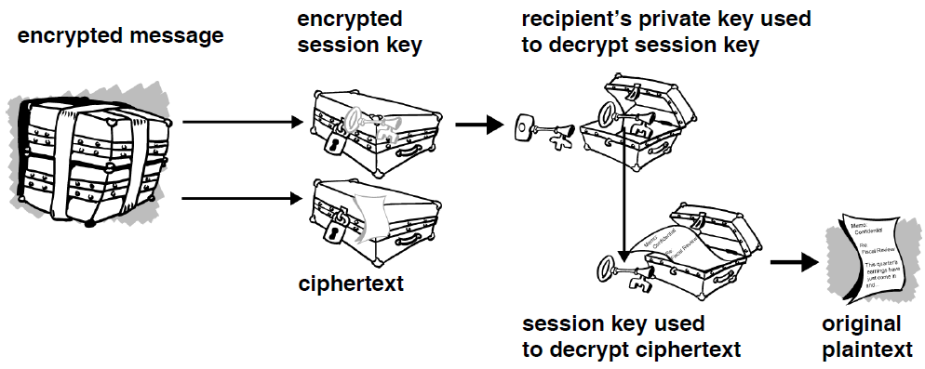
Pretty Good Privacy (PGP)
Figure: PGP Decryption

Slide 54
Pretty Good Privacy (PGP)
The combination of the two encryption methods combines the convenience of public-key encryption with the speed of conventional encryption.
Conventional encryptions about 1,000 times faster than public-key encryption.
Public-key encryption in turn provides a solution to key distribution and data transmission issues.
Used together, performance and key distribution are improved without any sacrifice in security.

Slide 55
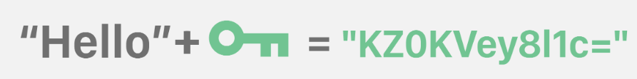
Keys
A key is a value that works with a cryptographic algorithm to produce a specific ciphertext.
Keys are typically designed to be both random and reasonably long.
In symmetric cryptography ,it can either be a number, a word or a string of random letters.
In asymmetric cryptography ,it is just numbers.

Slide 56
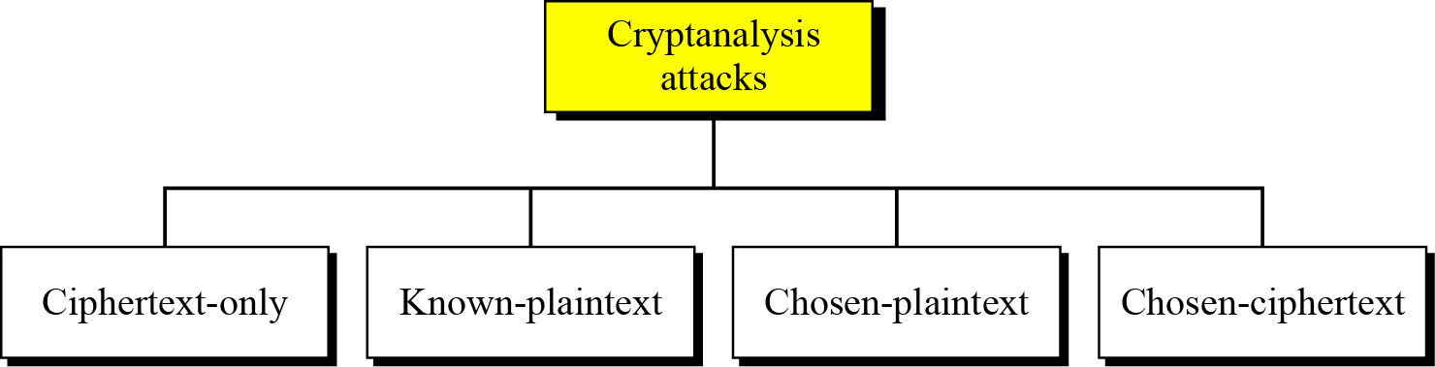
Cryptanalysis attacks
Figure: Cryptanalysis attacks

Slide 57
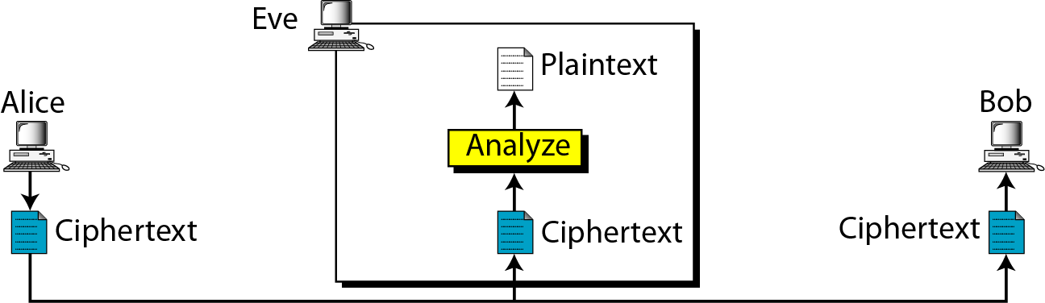
Figure: Ciphertext-only attack
In this attacker has access to ciphertext and it is assumed she know algorithm , so she just needs to find the corresponding key and plaintext.

Slide 58
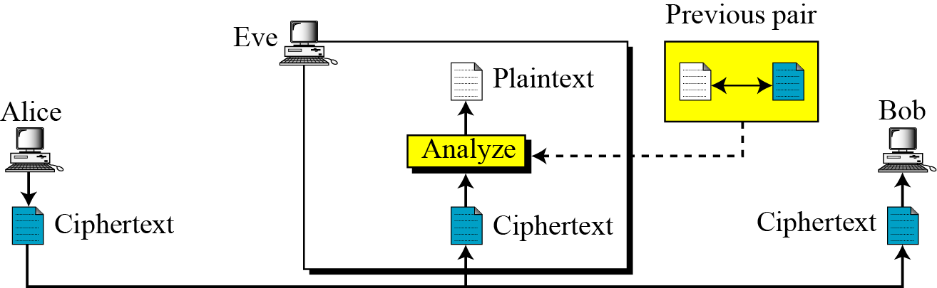
Figure: Known-plaintext attack
In this attacker has access to ciphertext/plaintext pair in addition to ciphertext she wants to break. She uses the relationship between previous pair to analyze the current text, provided key is unchanged.

Slide 59
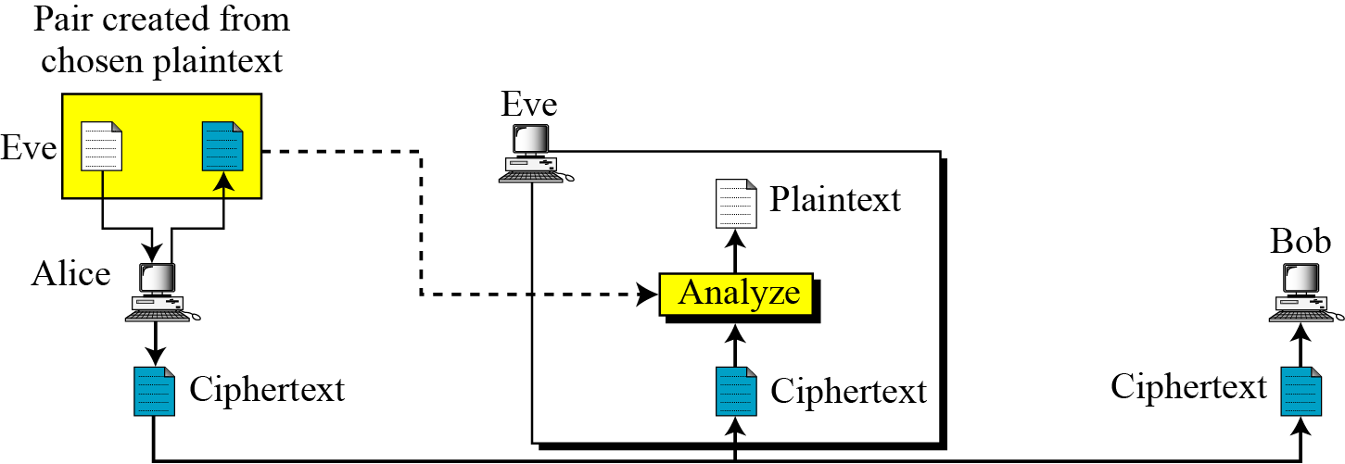
Figure: Chosen-plaintext attack
This is similar to known-plaintext attack, here the ciphertext/plaintext pair is chosen by attacker itself.
She has access to sender’s computer and chose plaintext herself and intercept corresponding ciphertext to form ciphertext/plaintext pair.

Slide 60
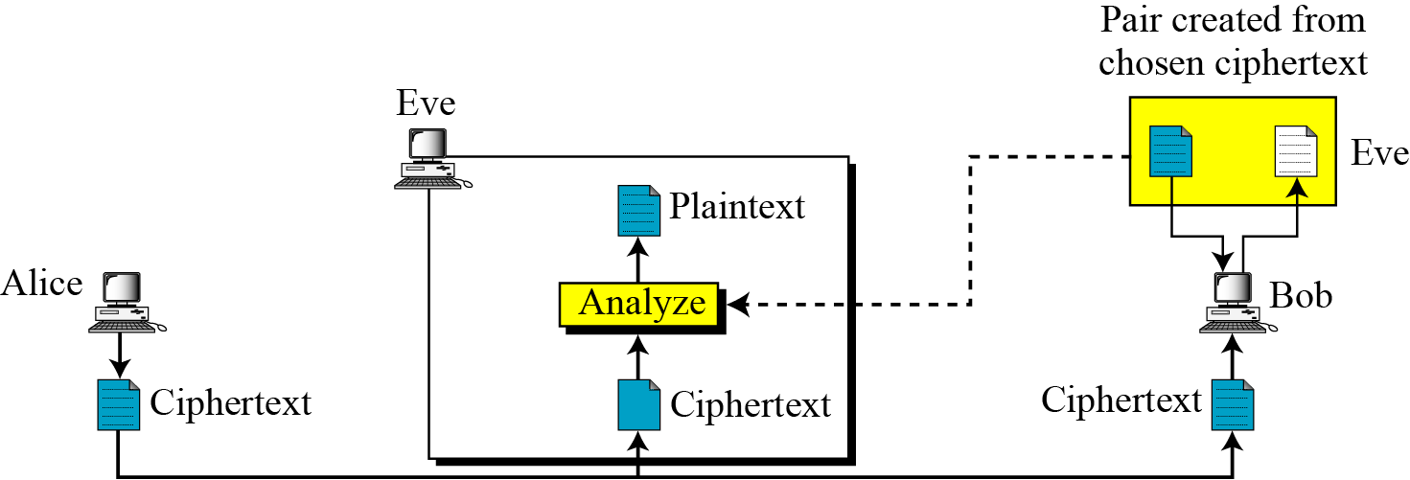
Figure: Chosen-ciphertext attack
This is similar to chosen-plaintext attack.
She has access to receiver’s computer and chose ciphertext herself and intercept corresponding plaintext to form ciphertext/plaintext pair.

Slide 61
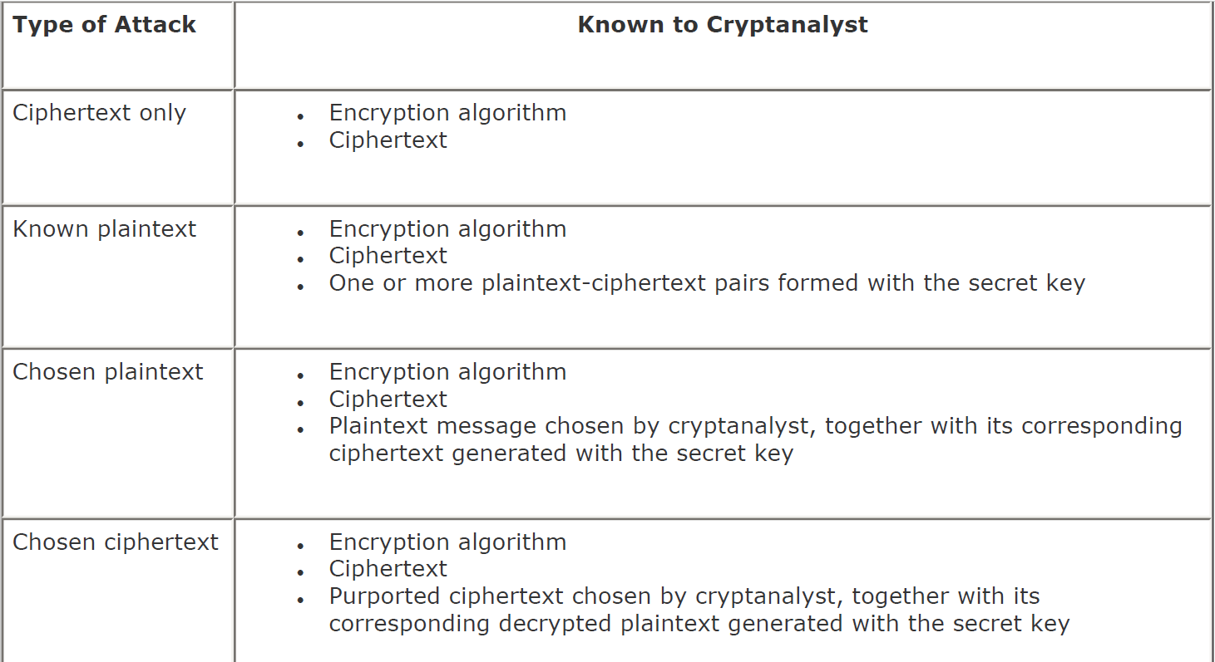

Slide 62

Message Integrity and Message Authentication

Slide 63
Message Integrity
The cryptography systems provide secrecy, or confidentiality, but not integrity
However, there are occasions where we may not even need secrecy but instead must have integrity.
e.g. a person may write a will for his family. Will doesn’t need to be encrypted. Anyone can read but its integrity needs to be preserved.

Slide 64
Document and Fingerprint
One way to preserve the integrity of a document is through the use of a fingerprint. If Alice (Sender) needs to be sure that the contents of her document will not be changed, she can put her fingerprint at the bottom of the document.

Slide 65
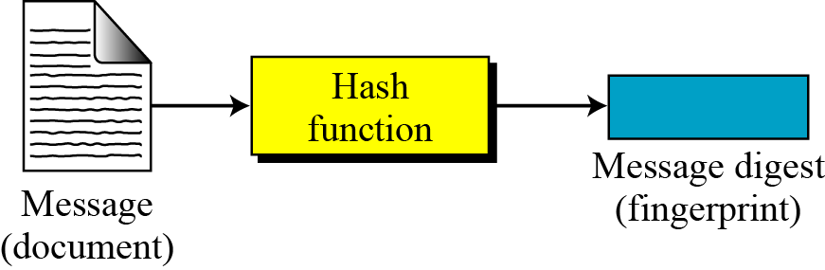
Message and Message Digest
The electronic equivalent of the document and fingerprint pair is the message and digest pair.
Figure: Message and digest

Slide 66
Difference
The two pairs (document / fingerprint) and (message / message digest) are similar, with some differences.
The document and fingerprint are physically linked together.
The message and message digest can be unlinked separately, and, most importantly, the message digest needs to be safe from change.

Slide 67
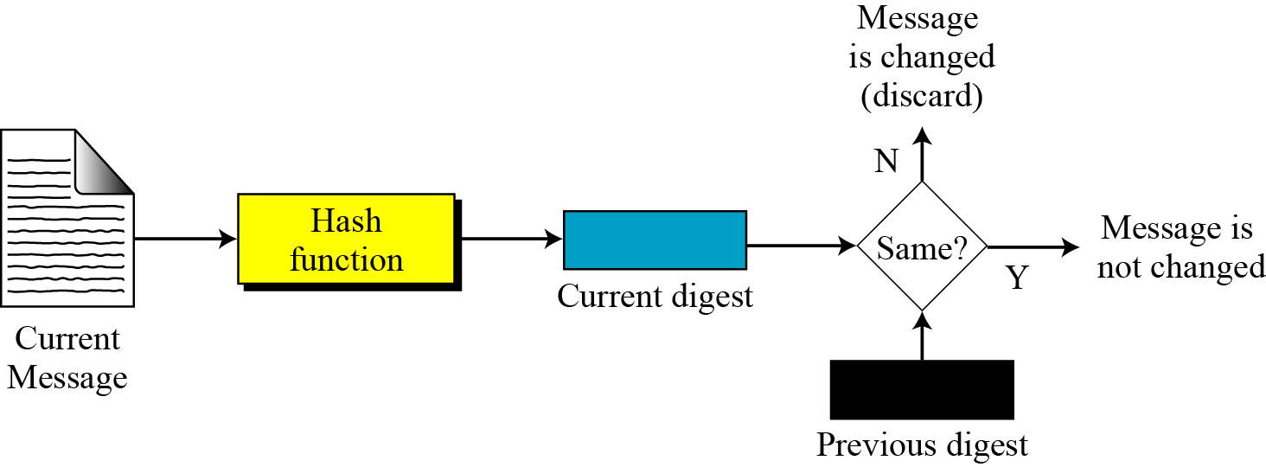
Checking Integrity
Figure: Checking integrity

Slide 68
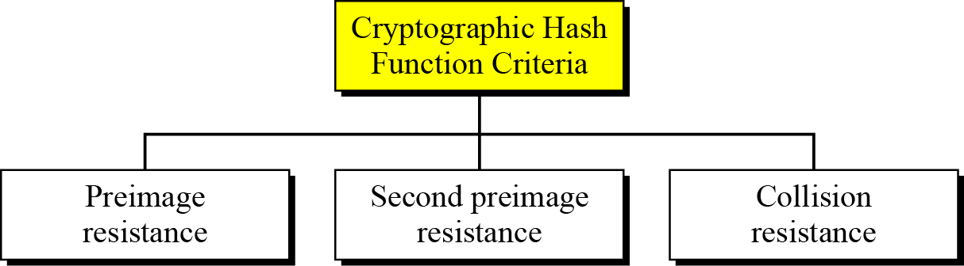
Cryptographic Hash Function Criteria
A cryptographic hash function must satisfy three criteria: pre-image resistance, second pre-image resistance, and collision resistance.

Slide 69
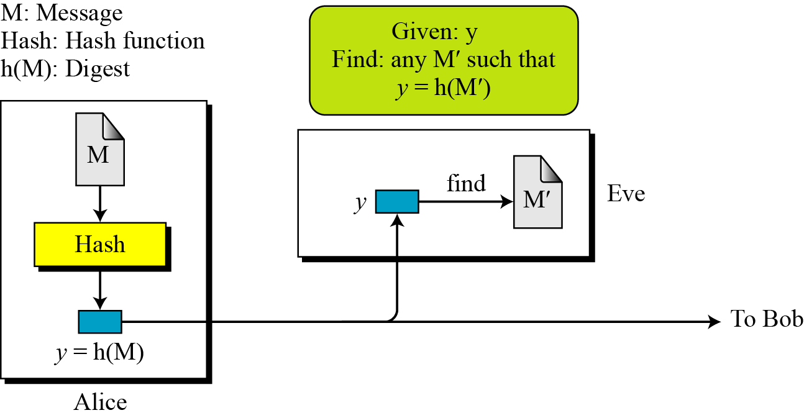
Pre-image Resistance

Slide 70
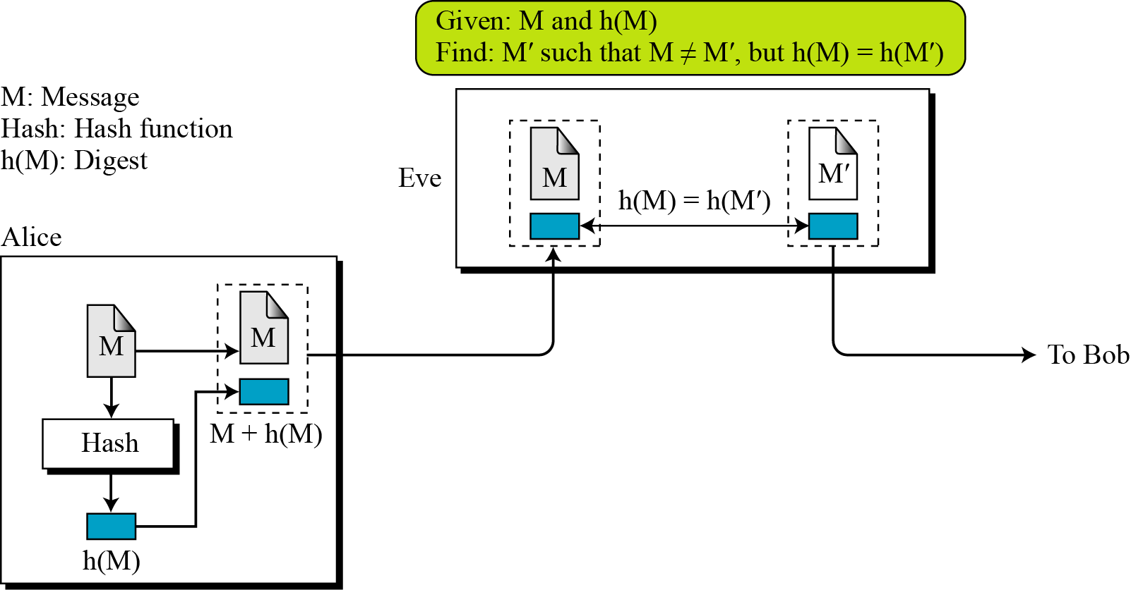
Second Pre-image Resistance

Slide 71
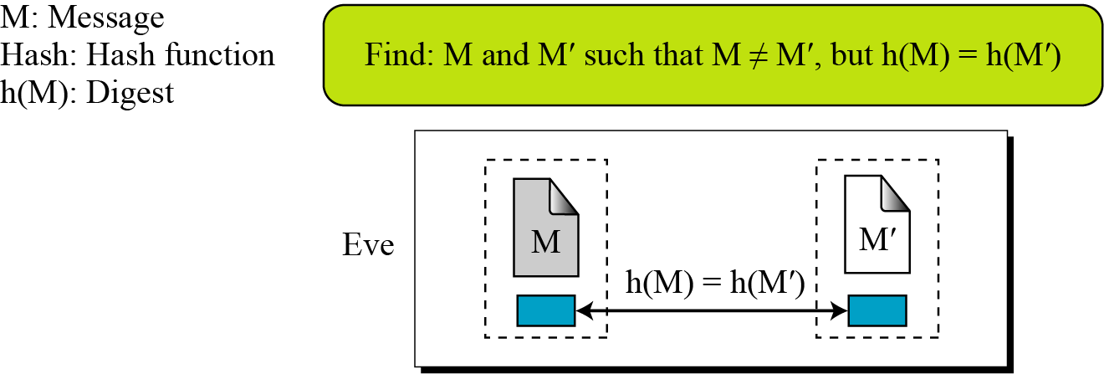
Collision Resistance

Slide 72
Message Authentication
A message digest does not authenticate the sender of the message.
To provide message authentication, sender needs to provide proof that it is sender sending the message and not an impostor.
The digest created by a cryptographic hash function is normally called a modification detection code (MDC).
We need for message authentication is a message authentication code (MAC).

Slide 73
Modification Detection Code (MDC)
A modification detection code (MDC) is a message digest that can prove the integrity of the message: that message has not been changed.
Sender can create a message digest, MDC, and send both the message and the MDC to Receiver.
Receiver can create a new MDC from the message and compare the received MDC and the new MDC.
If they are the same, the message has not been changed.

Slide 74
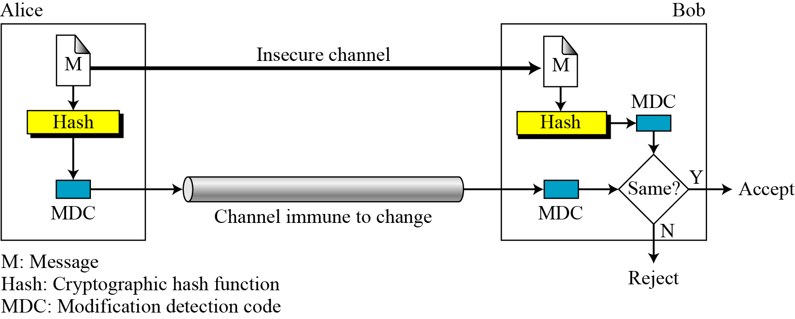
Figure: Modification detection code (MDC)

Slide 75
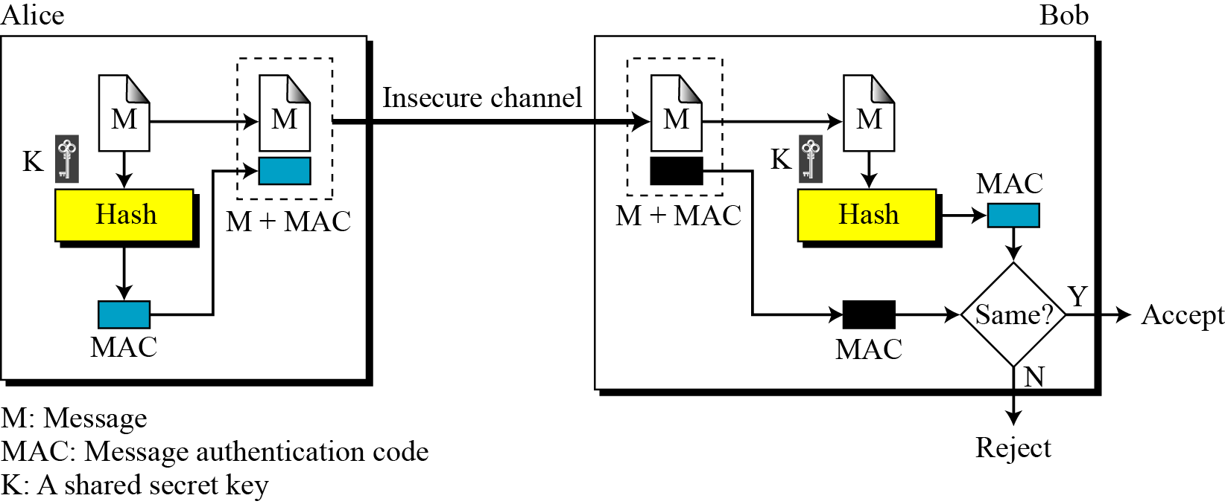
Modification Authentication Code (MAC)
In MAC sender and receiver shares a secret key which attacker doesn’t know about.

Slide 76

Digital Signature

Slide 77
Difference between conventional and digital signature
Inclusion:
A conventional signature is included in the document; it is part of the document.
But when we sign a document digitally, we send the signature as a separate document.

Slide 78
Difference between conventional and digital signature
Verification Method :
For a conventional signature, when the recipient receives a document, she compares the signature on the document with the signature on file.
For a digital signature, the recipient receives the message and the signature. The recipient needs to apply a verification technique to the combination of the message and the signature to verify the authenticity.

Slide 79
Difference between conventional and digital signature
Relationship :
For a conventional signature, there is normally a one-to-many relationship between a signature and documents.
For a digital signature, there is a one-to-one relationship between a signature and a message.

Slide 80
Difference between conventional and digital signature
Duplicity :
In conventional signature, a copy of the signed document can be distinguished from the original one on file.
In digital signature, there is no such distinction unless there is a factor of time on the document.

Slide 81
Digital Signature Process
The sender uses a signing algorithm to sign the message.
The message and the signature are sent to the receiver.
The receiver receives the message and the signature and applies the verifying algorithm to the combination.
If the result is true, the message is accepted; otherwise, it is rejected.

Slide 82
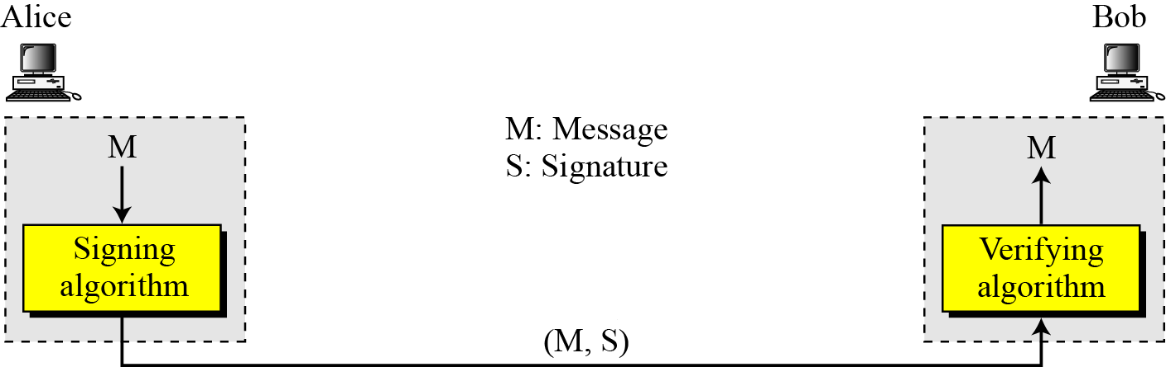
Digital Signature Process
Figure: Digital signature process

Slide 83
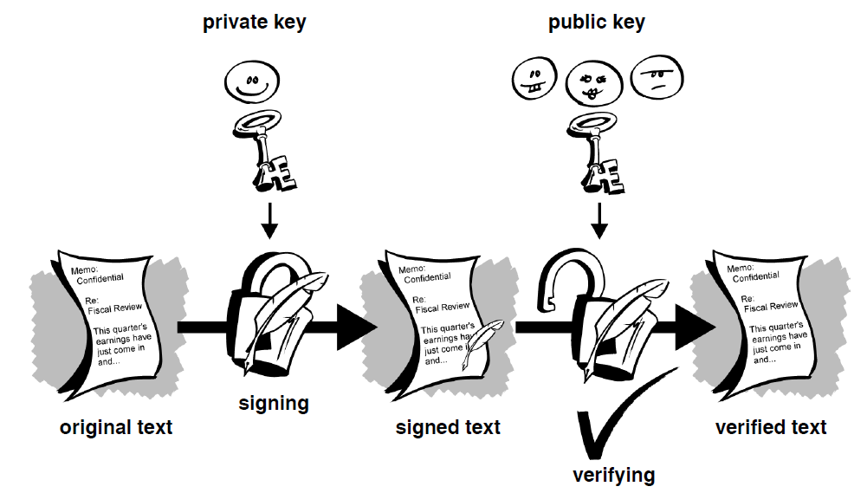
Digital Signature Process

Slide 84
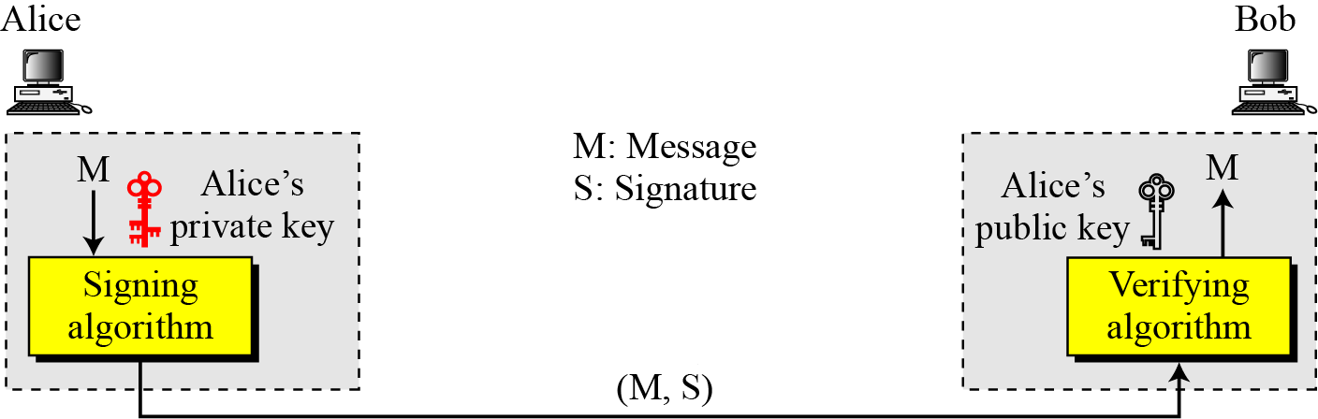
Need for Keys
The signer signs with her private key; the verifier verifies with the signer’s public key.
A cryptosystem uses the private and public keys of the receiver whereas a digital signature uses the private and public keys of the sender.

Slide 85
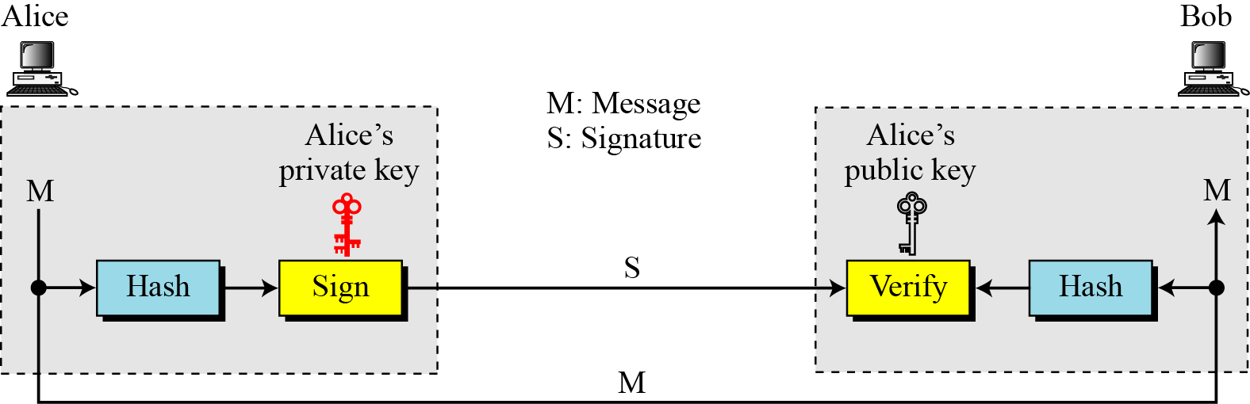
Signing the digest
Asymmetric-key cryptosystems are inefficient with long message.
Digital signature normally deals with long messages.
Solution is to sign the digest of the message which is shorter.

Slide 86
Services
Security services includes Message confidentiality, message authentication, message integrity, and nonrepudiation.
A digital signature can directly provide the last three; for message confidentiality we still need encryption/decryption.

Slide 87
Message Authentication
A secure digital signature scheme, like a secure conventional signature can provide message authentication.
Receiver can verify using public key of sender.
Message Integrity
The integrity of the message is preserved even if we sign the whole message because we cannot get the same signature if the message is changed.

Slide 88
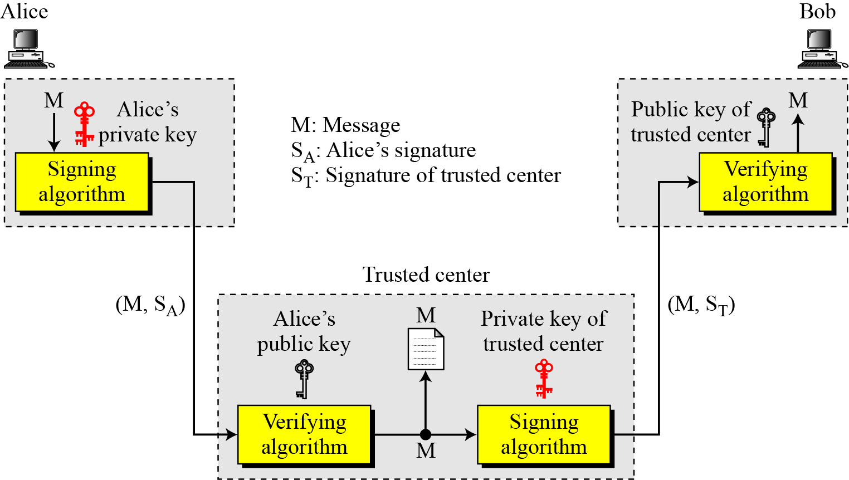
Non-repudiation
Non-repudiation can be provided using a trusted party.

Slide 89
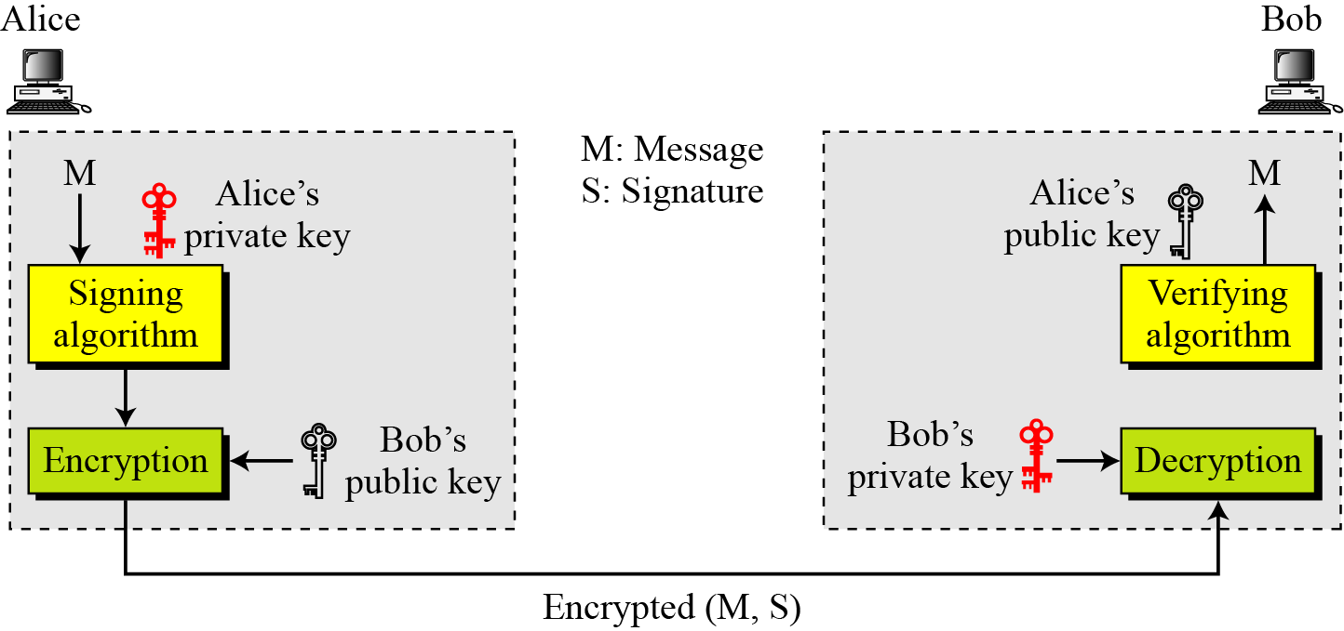
Confidentiality
A digital signature does not provide privacy.
If there is a need for privacy, another layer of encryption/decryption must be applied

Slide 90
Attacks on Digital Signature
Attack Types:
Key-Only Attack: Attacker is only given public verification key.
Known-Message Attack: Attacker is given valid signature for variety of messages known by attacker but not chosen by the attacker.
Chosen-Message Attack: The attacker first learns signatures on arbitrary messages of the attacker’s choice.

Slide 91
Attacks on Digital Signature
If attack is successful then the result is forgery.
Forgery Types:
Existential Forgery: Existential forgery is the creation (by the adversary) of any message/signature pair (m,$), where $ was not produced by the legitimate signer.
Selective Forgery: Selective forgery is the creation of any message/signature pair (m,$), where m has been chosen by the adversary prior to the attack.

Slide 92
Variations of Digital Signature
Time-stamped Signature: Sometimes a signed document needs to be time stamped to prevent it from being replayed by an adversary. This is called time-stamped digital signature scheme.
Blind Signatures: Sometimes we have a document that we want to get signed without revealing the contents of the document to the signer.

Slide 93
References
Cryptography and Network Security by Behrouz A. Forouzan.
Cryptography and Network Security by William Stallings.
Introduction to Cryptography by Markus K.G Adomey (AfricaCERT).
An Introduction to Cryptography by PGP Corporation.
Cryptography just for beginners from TutorialsPoint.

Slide 94

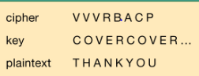
Thank You

